Slide 1
Wyndham City Council
Parks Asset Management
Open Spaces, Arboriculture, Conservation & Parks Assets
IPWEA Panel Presentation –
Shane Walden
Notes:
Good Afternoon, as you have heard I am Shane Walden, Manager Parks with Wyndham City Council.
Wyndham City’s Parks Department is broken into 4 key units:
Open Spaces – Mowing and Gardening
Arboriculture
Conservation
Parks Assets – Furniture, Equipment, Playgrounds, Graffiti and Public Art.
Wyndham’s Park Asset Management focuses on the organic and inorganic assets of the landscape.

Slide 2
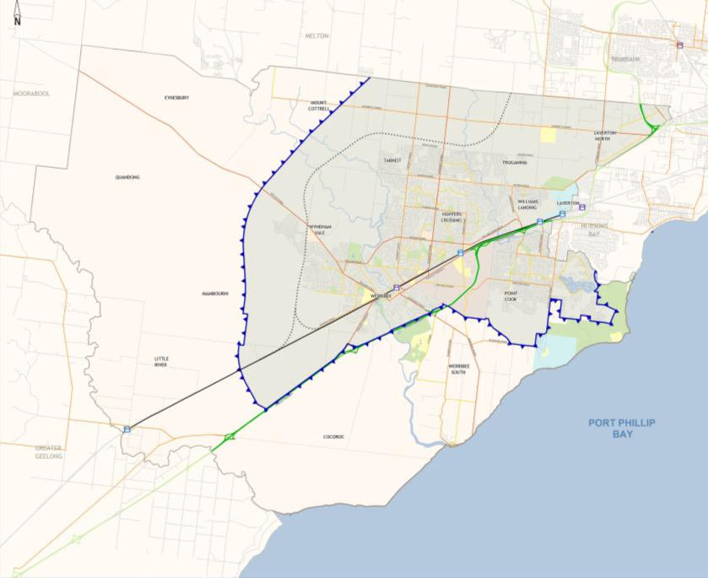
Wyndham City
542 KM²
27.4 KM Coastline
Designated Growth Corridor
Top 3 Growth Areas in Australia
Community TOP4
Transport
Parks & Recreation
City Image

Slide 3
Immediate Challenges
Complexity of Developer Design
Internal Handover Processes from:
Landscape Architects/Planners
Capital Works Teams – Major Projects, Buildings, Recreation, Roads.
Asset Management Systems
Funding

Slide 4
Goal
We are the stewards of the Community’s assets and ensure presentation in accordance with funded outcomes.
We provide safe, usable, sustainable and aesthetically appealing passive, active and conservation spaces for all sectors of the community.

Slide 5
Asset Management
5 Basic Principles:
Physical Scope – landholdings etc
Public Expectation
Design Capacity
Affordability
Structure

Slide 6
Management Levels
Asset Management Styles
Low level – basic period maintenance; field staff drive tasks.
Medium Level – moderate sophistication; asset base understood and attendances planned.
High Level – multi level sophistication; multiple management/maintenance models understood and best chosen for variable parameters.

Slide 7
Whole of Life Management

Slide 8
NB – Refer to 1.1 (Routine Surveys, On-going Inspections, Meetings and Reports) for further information on features outside the specific maintenance standard. NB – If the BBQ or Picnic Area is being used by the public, the service provider shall come back at a later time to clean the facility. NB – Refer to attachment 2 (schedule of BBQ and Picnic Areas)
Service Level Specification
Activity | BBQ and picnic area cleaning
Objective | All Barbeque and picnic table facilities shall be cleaned two times (2x) per week, except the Category A sites which are cleaned 7 days a week between 1December 2013 – 30 March 2014. All maintenance works shall be carried out so as not to compromise the integrity of the intent of parks assets design or structure ensuring the provision of an aesthetically pleasing and safe environment. BBQ is to be left in operating condition unless a defect is reported. All works are to be carried out using safe and environmentally friendly products. Ensure BBQ and picnic table’s life cycle is optimised through correct maintenance practices.
Exclusions | Installation, repair and/or replacement of BBQ’s and picnic tables.

Slide 9
Service Level Specification
Task | Measure | Minimum Freq
BBQ Cleaning | The following cleaning is required at all BBQ areas: Clean hotplate and bench tops (Steam clean or other methods may be considered by Council); Scrape of the hot plate and surrounds with a flat blade scraper to remove fat and food scraps, paying particular attention to corners and edges; Scour the surface to remove material that is cooked onto the surface or other build up or rust; Fat trays to be emptied and cleaned; Ensure that the hot plate drainage hole is free of obstructions; Clean all spills surrounding BBQ’s NB Fat and food scraps shall be disposed of in an appropriate manner to a tip site nominated by the Contractor. It must not be disposed of into the sewage or stormwater drainage systems or to public litter bins. | 2 per week (except during the nominated periods).
Table and Bench Top Cleaning | Detergents and/or soap shall be used to clean surfaces. There are a mixture of bench surfaces, including wooden, metal (iron, aluminium or other) and masonry. The following is required at all picnic areas: Wet wash cloth to wipe down the table; Wash and wipe tables and seatings; and. Clean all spills surrounding the tables and seating. | 2 per week (except cat A during the nominated period).
Repairs | At the completion of cleaning turn on BBQ and check it is functioning, report any issues/damage for repair | Within one working day.
 | Visually check the condition of all BBQ’s and picnic tables and report any requirements for upgrades or repairs | Within one working day.
Litter Control | Remove all litter within a 5 meter radius of picnic tables and BBQs Leaf blow surrounding paved area. | 2 per week (except cat A during the nominated period).

Slide 10
Measurement
Binary – Yes / No
Holistic but Localised
Public Information
Public Action Plans

Slide 11
Future Challenges
Executive and Councillor Buy-in – 1 message
Better WOL modelling of projects
Design with maintainability in mind
Standardisation of designs
Maintenance intent documentation

