Slide 1
Metropolitan Planning Strategy
Infrastructure, Economy, Opportunity
Bernard McNamara
Member, Ministerial Advisory Committee (MAC)
for the Metropolitan Planning Strategy
March 2013

Slide 2
Where are we up to?
Discussion Paper , October 2012
Community consultation, workshops, business, local govts,
Submissions to end March 2013
Draft Strategy and draft SPPF July 2013
Submissions/Consultation Aug- Sept
Strategy approved, new SPPF Nov 2013
A Distinctive Melbourne A Globally Connected and Competitive City Social and Economic Participation Strong Communities Environmental resilience | A Polycentric City linked to Regional Cities Living Locally – a ‘20 minute’ City | Infrastructure investment that supports city growth Leadership and Partnership

Slide 3
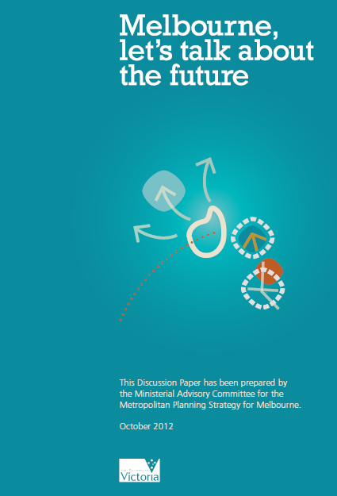
The discussion paper offers 9 Principles and 16 ideas as a conversation starter for planning the future of metropolitan Melbourne.

Slide 4
What is different about this proposed strategy?
A metropolitan framework for jobs - more jobs in the suburbs
Addressing the growing inequities between the central and inner suburbs and the outer and growth areas
Linking social and economic participation to productivity
A focus on access and equity: increasing “life chances”
Implementing a pipeline of hard and soft infrastructure
Building our next generation of civic projects e.g. boulevards
Establishing health &well being, life learning education precincts
Putting buses on the PT agenda as a priority
Unlocking the capacity of the established suburbs
A Distinctive Melbourne A Globally Connected and Competitive City Social and Economic Participation Strong Communities Environmental resilience | A Polycentric City linked to Regional Cities Living Locally – a ‘20 minute’ City | Infrastructure investment that supports city growth Leadership and Partnership

Slide 5
What we want to achieve
Principle 1: A distinctive Melbourne
Principle 2: A globally connected and
competitive city
Principle 3: Social and economic
participation
Principle 4: Strong communities
Principle 5: Environmental resilience
A Distinctive Melbourne A Globally Connected and Competitive City Social and Economic Participation Strong Communities Environmental resilience | A Polycentric City linked to Regional Cities Living Locally – a ‘20 minute’ City | Infrastructure investment that supports city growth Leadership and Partnership

Slide 6
What needs to change
Principle 6: A polycentric city linked to
regional cities
Principle 7: Living locally – a ‘20 minute’
city
A Distinctive Melbourne A Globally Connected and Competitive City Social and Economic Participation Strong Communities Environmental resilience | A Polycentric City linked to Regional Cities Living Locally – a ‘20 minute’ City | Infrastructure investment that supports city growth Leadership and Partnership

Slide 7
Making it happen
Principle 8: Infrastructure investment that
supports city growth
Principle 9: Leadership and partnership
A Distinctive Melbourne A Globally Connected and Competitive City Social and Economic Participation Strong Communities Environmental resilience | A Polycentric City linked to Regional Cities Living Locally – a ‘20 minute’ City | Infrastructure investment that supports city growth Leadership and Partnership

Slide 8
Financing and Funding
Set priorities, timelines and put processes in place to deliver the hard and soft infrastructure – can we do this at the regional level?
How are we going to pay for the infrastructure to maintain our city’s liveability, support its economic prosperity and enhance our social well-being?
How can we share the cost of providing such infrastructure as well as share the benefits of growth in a fair and equitable way?

Slide 9
Metroplo
Metropolitan Planning Strategy
Themes

Slide 10
MELBOURNE – CITY OF CHOICE & OPPORTUNITY
Our challenges (e.g. 70/30 split for future pop. growth)
Our principles
Our strategy for the future
Sharing the benefits and sharing the responsibilities
Building from the neighbourhood to the metropolis
The layout of our city affects our life chances
Choice and capability
“Place” as a central organising element for the MPS
Equity

Slide 11
JOBS AND SKILLS
Economic pillars and drivers of growth
Reducing the difference in productivity between the inner the outer areas
Creating more jobs and better access to jobs
‘Life chances’
Building a resilient economic future

Slide 12
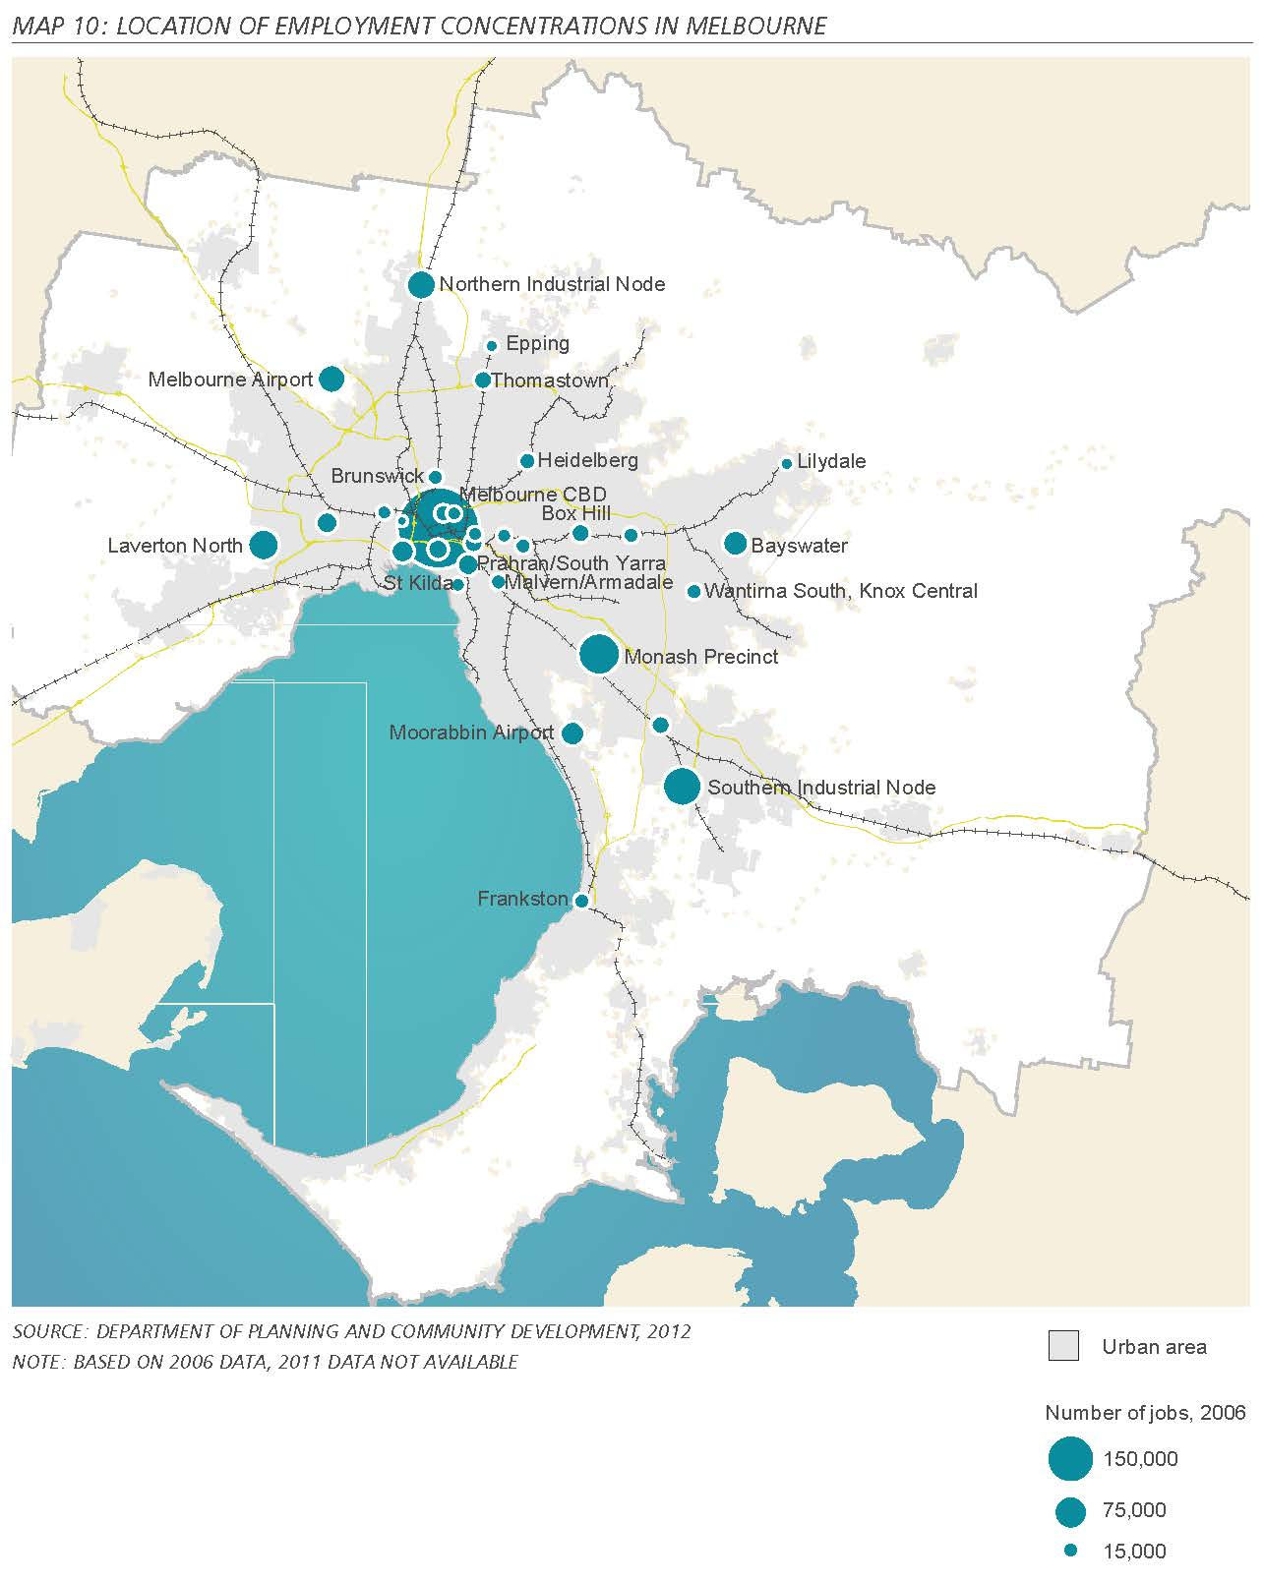
More jobs in the suburbs
Increasing job densities and expanding types of jobs
Nationally Significant Innovation and Employment Clusters (e.g. Monash cluster), west? and north? –
Reduce cross city commute, increase productivity levels and reduce greenhouse emissions.
20 minute city concept – live and work locally.
Access is really important - Buses and more buses, walking and cycling.

Slide 13
HOUSING
Narrative: Right housing, right price, right location.
Population growth
Balancing the growth
Living affordability
Housing to meet our needs
Innovation in the housing market ; Alternative approaches to delivering housing
Regional housing targets
Dwelling types and numbers
Density and form
Mixed-use development
Social Housing

Slide 14
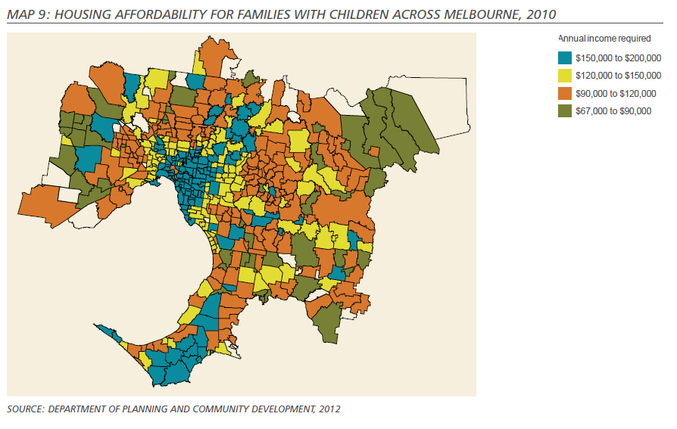
Living affordability

Slide 15
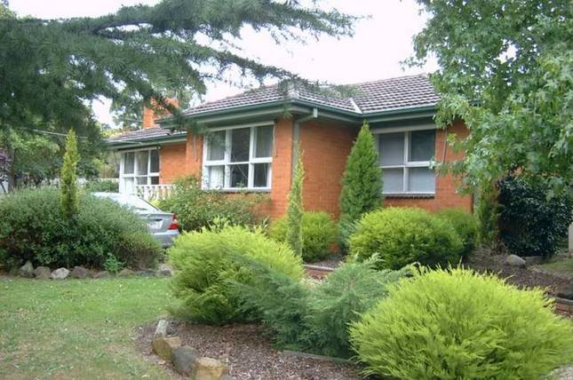
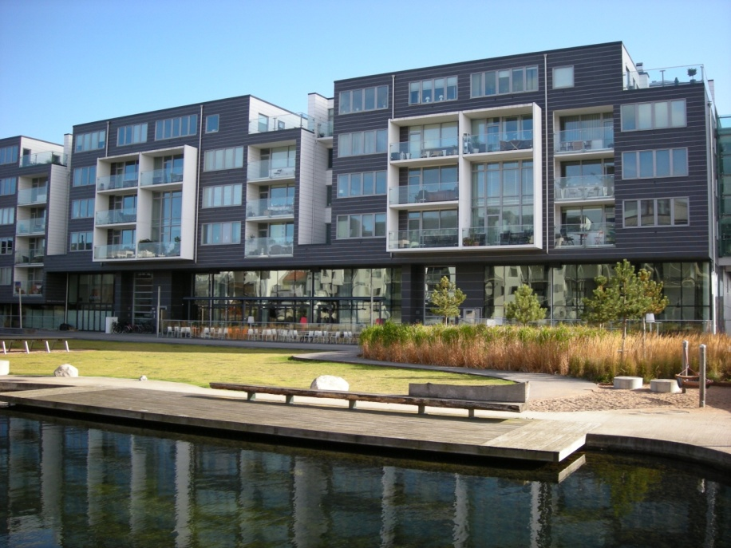
Housing choice to match your budget
Delivering diverse housing in the right locations at a reasonable price
End of life housing stock
Downsizing to smaller dwellings – incentives?
Unlocking the capacity of established suburbs so that young and old can live in these areas?
More social housing
How can we get $100,000 off the cost of construction of a 3 bedroom dwelling in the middle suburbs?

Slide 16
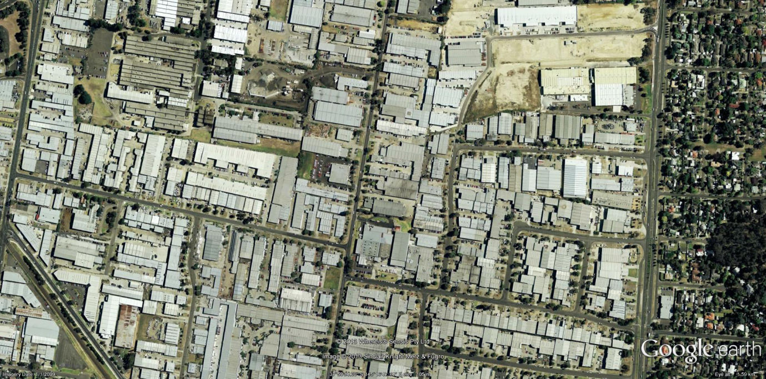
Urban Renewal Precincts and Urban Infill Sites
Brownfield and Greyfield sites – how to make productive?
Criteria for the identifying suitable sites and precincts for urban renewal and urban infill
What planning mechanisms can we apply to facilitate mixed use development in locations where we want it to occur?
Urban amenity and the importance of place making in all new development.

Slide 17
NEIGHBOURHOOD
Narrative: Living and working locally – the 20 minute city
Different densities deliver different services and facilities
Building sustainable communities
Place-making in your neighbourhood

Slide 18
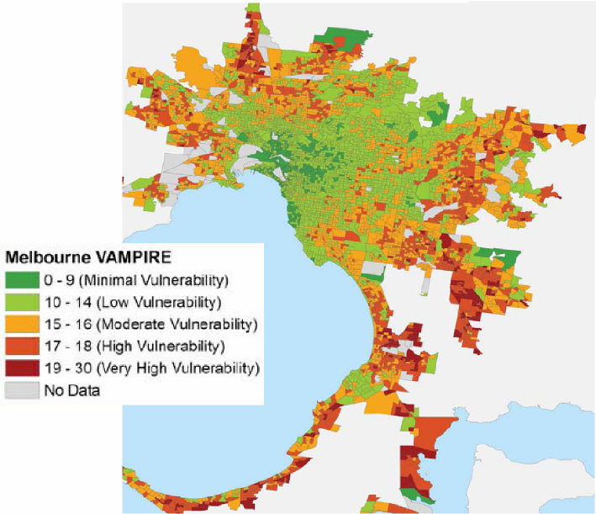
Strong, healthy and inclusive communities
Social sustainability – about people’s quality of life now and in the future.
Create neighbourhoods that support individual and collective well-being
Education and Health precincts – metropolitan, regional and local scales
Make our neighbourhoods better places to live and work
How can we accommodate different types of housing to enable people to age in their local area?
Greening our suburbs
Vulnerability Assessment for Mortgage, Petrol and Inflation Risks and Expenditure (VAMPIRE index)
Source: Dodson & Sipe 2008 based on 2006 Census

Slide 19
TRANSPORTATION
Narrative: The importance of accessibility; its linkages to productivity and social and economic participation.
Support economic growth of the city.
Deliver desired urban form
Build a fairer city
Reduce environmental footprint from travel

Slide 20
IDENTITY AND PLACE
Narrative: Distinctive Melbourne and the importance of design and culture in creating quality places across metropolitan Melbourne
Heritage, Culture, Civic pride, Valuing design culture
Creativity/ Arts within the city
Place-making, Corner sites
Country in the City, Greening
Tramway corridors
Parks, including new regional parks
Boulevards
Waterways
Botanic Gardens in the west
Expanded Central City; Transit oriented development
Roads as shared spaces

Slide 21
ENVIRONMENT
Narrative: Melbourne’s ecological footprint is excessive. The impacts of climate change and extreme weather events need to be tackled at the metropolitan and local levels.
Melbourne’s edge: “hard” UGB
Greening Melbourne
Sustainable design and construction
Improving the environmental performance of the suburbs
Green infrastructure

Slide 22

Green edge to the metropolis
Is it time to set in stone an Urban Growth Boundary?
If so where do we accommodate additional people, jobs and facilities?
Enhance the environmental qualities of the peri urban fringe?
The role for more food production and tourist related opportunities outside the UGB and still retain a ‘green’ setting?
Plans for each “Green” wedge

Slide 23
HEALTH AND WELL-BEING
Narrative: The connections between having a job when you want one, a home and connections to your neighbourhood correlate with the health, well-being and safety of our communities.
Future of health care
Child care
Youth facilities
Ageing and accommodation
Primary care, Secondary care, Acute care
Health and well-being hubs
Local medical facilities
Providing for NGOs
Preventative health, Physical activity, Active participation
Healthy Together Victoria
Recreation

Slide 24
WATER, ENERGY, WASTE
Water strategy, Waste water infrastructure
Energy security, alternative energy sources
Distributed energy (co-generation, tri-generation)
Waste strategy, Recycling
Industrial ecology
Contaminated waste
Contaminated sites and brownfields remediation
Hazardous waste
Agri-business opportunities

Slide 25
VICTORIA: the bigger picture
Spatial framework
Regional Growth Plans across Victoria
Regional cities growth opportunities Corridors to regional cities
Infrastructure planning by region
Outer Metropolitan Ring Road, Melbourne Airport links
Very Fast Train reservation
Small towns
Peri-urban
Inter-urban break

Slide 26
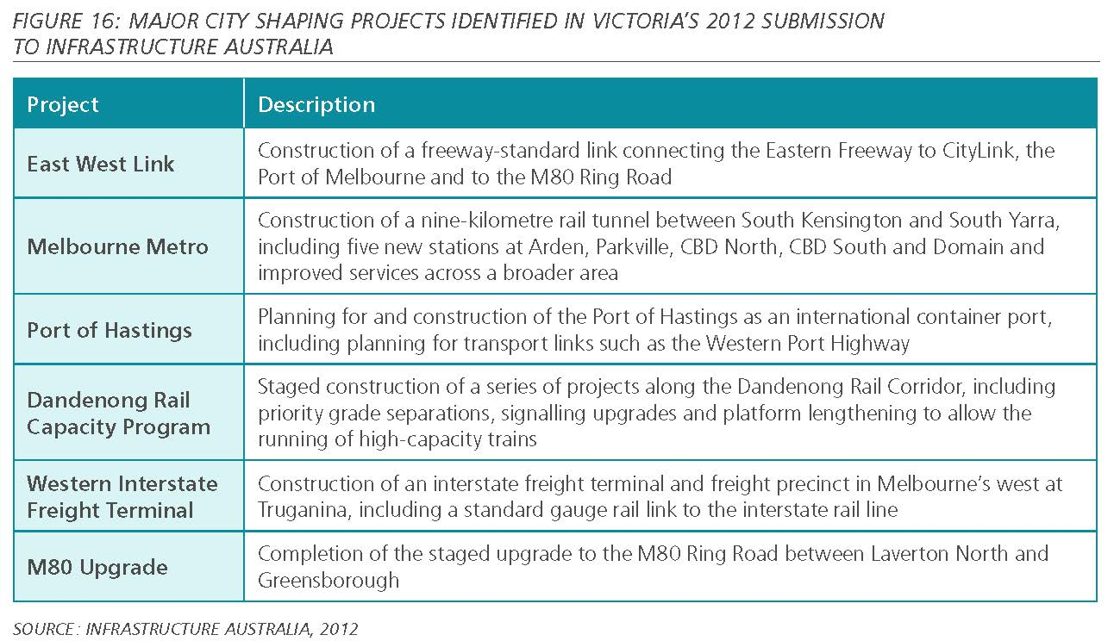
Implementing the MPS – perhaps our biggest challenge

Slide 27
IMPLEMENTATION: How and Who
Integrated service delivery
Public sector roles and responsibilities
Private sector roles, responsibilities, opportunities
Inter-governmental cooperation (Federal, State, Local)
Regulation
Partnerships
Governance:
Metropolitan Planning Authority
Regional groups
Local council
Neighbourhoods

Slide 28
Implementation: Funding and funding
Sources of Funds:
  Federal, State, Local, Private,
  Development Levies
  Value Capture
  User Pays
  Metropolitan Improvement Levy?
Plans (include draft costings)
  Short-term plans (1-5 years)
  Medium-term plans (5-10 years)
  Long-term plans (10+ years)
Measuring and monitoring our progress

Slide 29
Some Ideas for Change

Slide 30
Grow the Central City as the anchor of a world city
Build an expanded Central City: Footscray to Fishermens Bend
Core location of the knowledge economy: universities, research, professions, finance and business
Mass transit to support agglomeration
    Melbourne Metro Rail project vital
    Light rail to Fishermans Bend and E-Gate area
  Tram/light rail, bus, walk, cycle for local
Inner areas
        Tram/light rail, bus, walk, cycle
        East –West as bypass,
        Must include place transformation with infrastructure projects

Slide 31
Build national employment and innovation clusters
Invest in suburban clusters where jobs and competitive advantages can be maximised
Job and economic base different but higher value jobs essential
Parkville, Monash, Melbourne Airport,
North: La Trobe?
West: Sunshine?
South west: Werribee?
Potential new clusters?

Slide 32
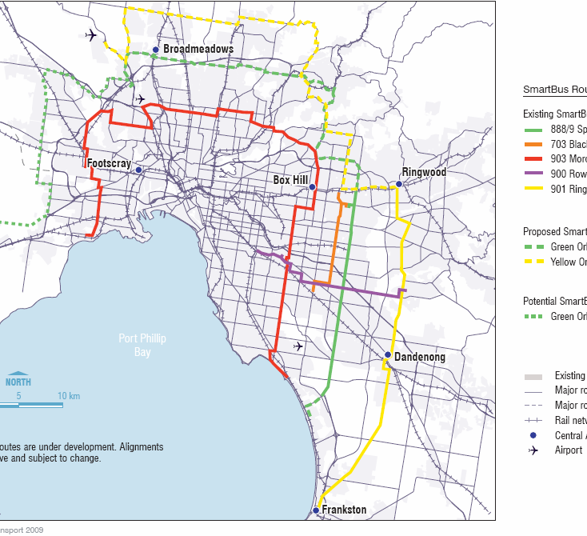
Providing a transport system for Melbourne’s future
Melbourne’s SmartBus network
Middle/outer areas
        Bus for trunk services feeding nodes/clusters and local circulation
          Will be a strong circumferential movement role in larger cities
        Connect growth areas to jobs (and seek local job growth)
        Provide new bus services when fringe estates commence, not after car ownership is embedded
        Increase walking and cycling opportunities
          Also promotes health and safety
        Use road corridors to promote distinctiveness throughout city (such as boulevards)

Slide 33
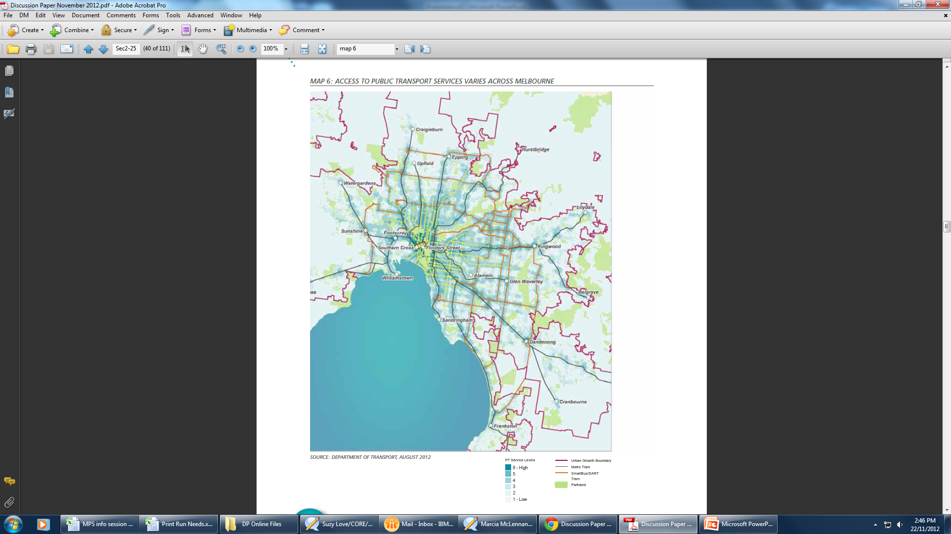

Slide 34
Using Investment to Transform Places
Infrastructure spending represents the big opportunity for transforming places
The way we see projects as one dimension prevents us form achieving this.
Are we achieving all we should from $5bn RRL?
Should e.g. Education Dept land be seen as that or community assets that can be used to deliver community outcomes: sell with deliverables
Private sector initiatives
Set up for unsolicited private sector infrastructure proposals

Slide 35
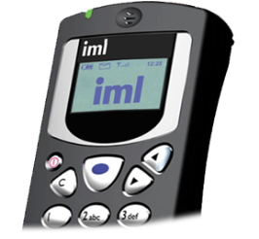
Community forum: what people think matters

Slide 42
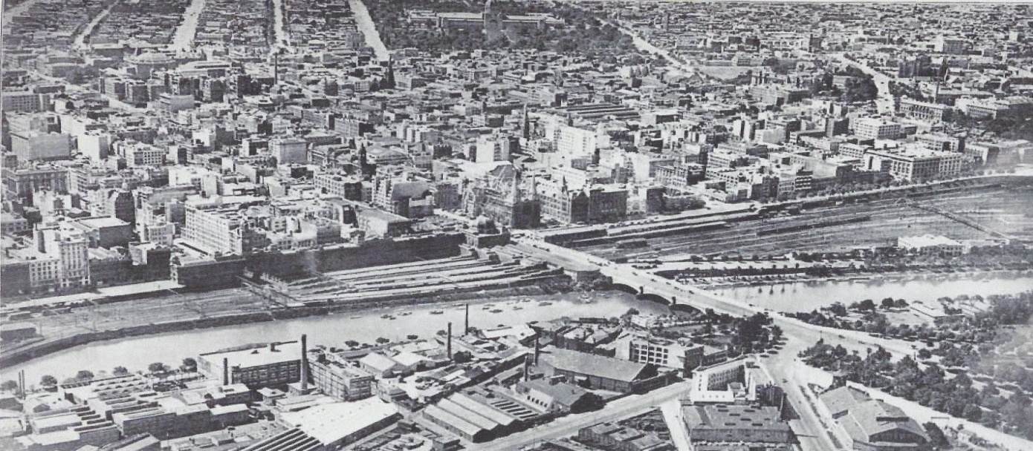
84 years ago………
‘In the interests of its people a city must be planned with two objectives in view – that of conducting business in the most efficient manner, and that of conferring the greatest benefits to the greatest numbers.’ (Plan of General Development, Melbourne, Report of the Metropolitan Town Planning Commission, 1929)

